Slide 1
Intro to AI in Medicine
Lec 13: Fairness & Bias in Medical AI

Slide 2
Last Time
Project Intro
Read over PowerPoint, word doc is streamlined version
I will be available for questions after class

Slide 3

This Time
Exploring the ways AI algorithms exhibit bias, harmful and otherwise
Recap of bias from other lecture
Let what you’ve learned about AI algorithms inform your opinions
Lots of discussion! You guys know more than me
Topics can be heavy so let’s tackle them with an open mind

Slide 4
Bias in Data
As we attempt to extract patterns from our data we must beware of sources of bias
Bias really falls in one of two buckets:
Our data does contain, but is due to another factor not captured in data
Our data fails to capture
How we formulate our problem has a massive impact!
What are we hoping to extract from the data
How do we preprocess data to exclude or counterbalance sources of bias
Notes:
Top: differences in loan repayment by race. It’s true that it’s in the data, however the social forces that drive that outcome are not easily captured in dataset
Bottom:

Slide 5
Types of bias we discussed…
Historical Bias
Patterns in data that reflect inequalities that have occurred as a result of some factor not captured in the model
Ex. Amazon hiring
Sample Bias
Sample not representative of whole population
Ex. Underinsured patient population not present in rich private hospital
Aggregation Bias
Collapsing together clinically meaningful but different subgroups
Thymus read as pathology on pediatric chest x-rays
And many more…

Slide 6
Recall
Biased data leads to biased outcomes
Ex. Regression model – any inequities will be learned and propagated
Data cleaning involves removing these markers from data
The decision you want to inform should be in mind when designing model
Loss function is critical – what is your outcome metric
Minimizing readmissions will lead to different decisions than minimizing expenditures

Slide 7
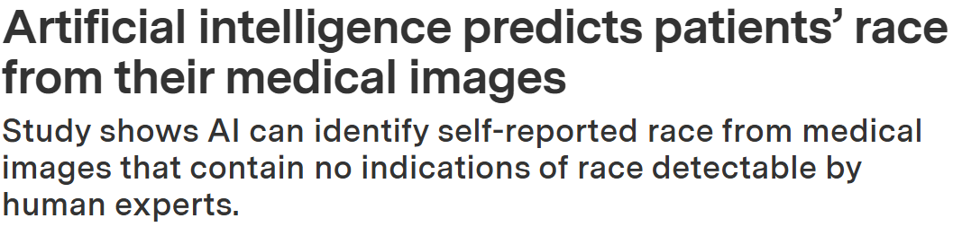
Case Study
How does this work?
Input data
Problem type
Training regime

Slide 8
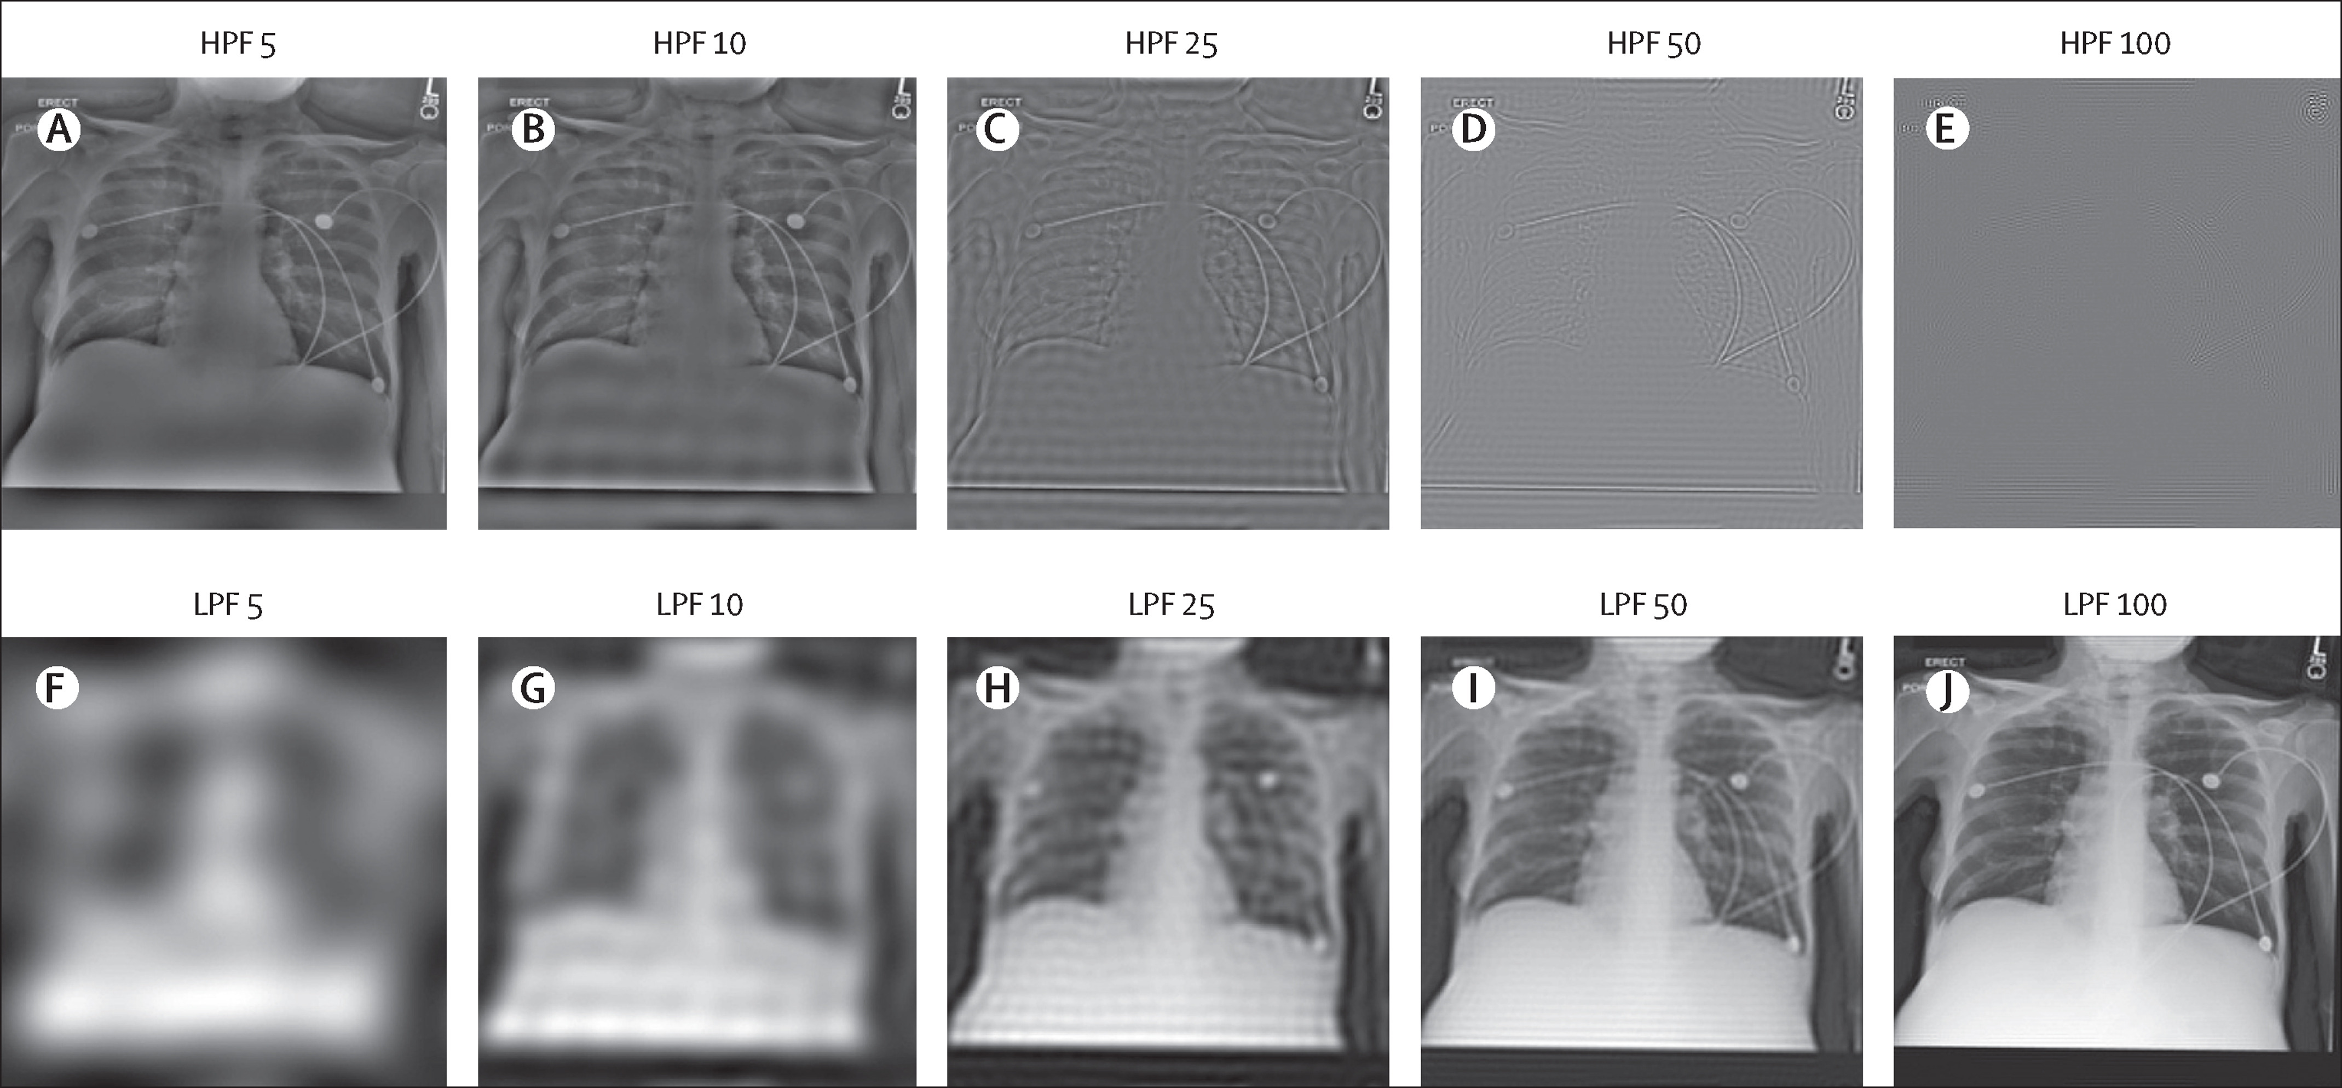
Case Study
Results:
AUROC = .96-.94 for prediction of race, even when filtered to only show borders of body structures (done to eliminate bone density)
When only using tabular data, AUROC fell to 0.54-0.61
What implications does this have for clinical practice?
What does this say about what models are learning?

Slide 9
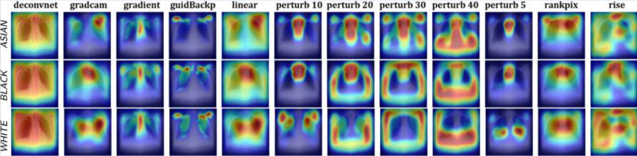
Case Study
How can we learn more about what these models are using to predict?
GradCam - > backpropagate which features have large role
Perturb - > find regions, which when removed, change prediction most
Low frequency features: those features which are subtle and spread throughout image (tissue density, overall brightness/x-ray transparency)
https://pmc.ncbi.nlm.nih.gov/articles/PMC11871413
Notes:
that the trachea, portions of the shoulders, and parts of the lungs are the most salient locations for predicting the classes.

Slide 10
Case Study
How can we learn more about what these models are using to predict?
Unintended proxies - > certain scanner scans more people of one race, has certain metadata, can be used to predict race
Better logging can help us identify and remove (or at least class balance) these features.
https://pmc.ncbi.nlm.nih.gov/articles/PMC11871413
Notes:
that the trachea, portions of the shoulders, and parts of the lungs are the most salient locations for predicting the classes.
Lecture on interpretability to come

Slide 11
Case Study
Should we fight this?
Is it necessary to remove this information?
What level of accuracy is worth sacrificing for anonymization?
How can we evaluate if the identification of race/other features is causing our model to make predictions which have a clinical impact?
If so, how?
Learn what features are important, then remove them
Train models to optimize performance on the worst-performing subgroup
Adversarial debiasing
Balance data beforehand
Notes:
Ad: train discriminator to predict race, then train model to maximize performance while minimizing performance of discriminator

Slide 12
Definitions of Fairness
Demographic Parity (Statistical Parity)
The AI system produces the same proportion of positive predictions across different groups
Example: A diagnostic tool flags 15% of patients for follow-up testing regardless of race/gender
Medical consideration: This may not be clinically appropriate if disease prevalence actually differs between groups
Equalized Odds
True positive rates (sensitivity) AND false positive rates are equal across groups
Equal Opportunity (similar to above)
True positive rates (sensitivity) are equal across groups

Slide 13
Definitions of Fairness
Predictive Parity (Positive Predictive Value)
when the model says "positive," it's equally likely to be correct across groups
Example: When an AI flags a suspicious lesion, it's actually cancer 70% of the time for all groups
Medical consideration: Important for resource allocation decisions

Slide 14
The Impossibility Theorem
You generally cannot satisfy all fairness metrics simultaneously when base rates (disease prevalence) differ between groups.
This is known as the "fairness impossibility theorem.“
For example, if Disease X affects 20% of Group A but only 5% of Group B:
Maintaining equal false positive rates AND equal true positive rates will violate demographic parity
Achieving demographic parity will likely harm calibration

Slide 15
Practical Steps to Mitigate Bias
Planning Phase
Define fairness goals explicitly before model development
Identify relevant protected attributes (race, gender, age, socioeconomic status)
Engage stakeholders from affected communities
Determine which fairness metrics are appropriate for your clinical use case
Data Collection & Preparation
Ensure diverse, representative training data across all relevant subgroups
Document data provenance and collection methods
Examine and report demographic composition of datasets
Check for and address selection bias in recruitment
Validate that labels are consistent and unbiased across groups

Slide 16
Practical Steps to Mitigate Bias
Model Development
Stratify data analysis by demographic subgroups from the start
Avoid using race/ethnicity as direct features unless clinically justified
Be cautious of proxy variables that correlate with protected attributes
Consider fairness-aware training methods (adversarial debiasing, constrained optimization)
Use interpretable models when possible to identify potential sources of bias
Evaluation & Validation
Report performance metrics separately for each demographic subgroup
Evaluate multiple fairness metrics (not just overall accuracy)
Test on external, diverse validation sets
Assess whether the model uses demographic "shortcuts" inappropriately

Slide 17
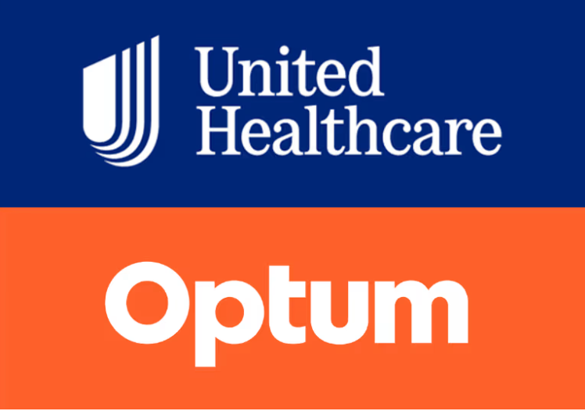
Case Study
Common insurance provider
Identify patients for “high risk care programs” via determining which patients will incur higher healthcare expenditures
What fairness goals should we identify?
What patient characteristics should be tracked and measured in the name of fairness?
Should any patient data be disregarded and considered irrelevant to predictions?
Notes:
Difficult to identify data collection bias without more info

Slide 18
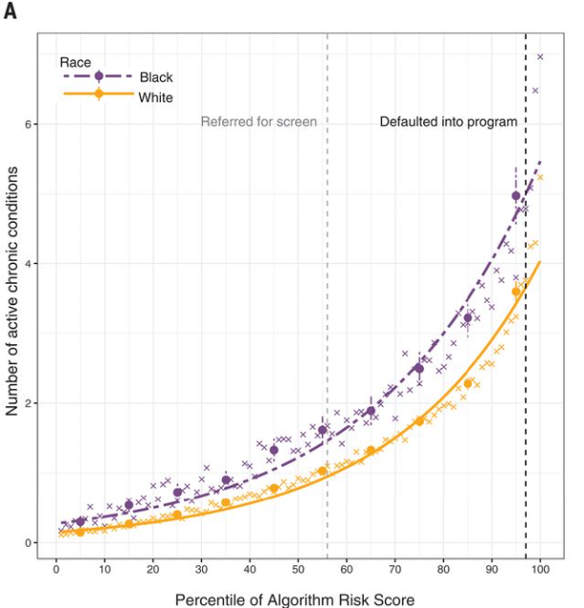
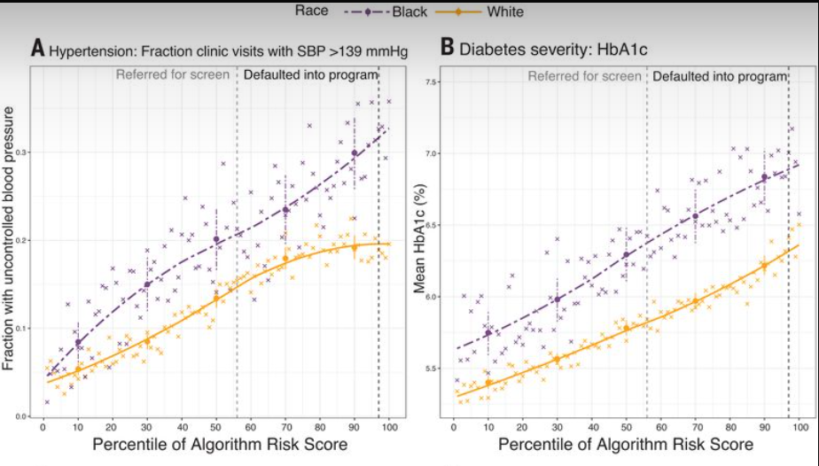
Case Study
Primary care patients for 2 years from a major health system
Assigned a given risk score based on PMH
Notes:
Even if you remove race, algorithms can learn as evidenced by the study prior
differences in severity of hypertension (systolic pressure: 5.7 mmHg) and diabetes [glycated hemoglobin (HbA1c): 0.6%] imply differences in all-cause mortality of 7.6% (27) and 30% (28)

Slide 19
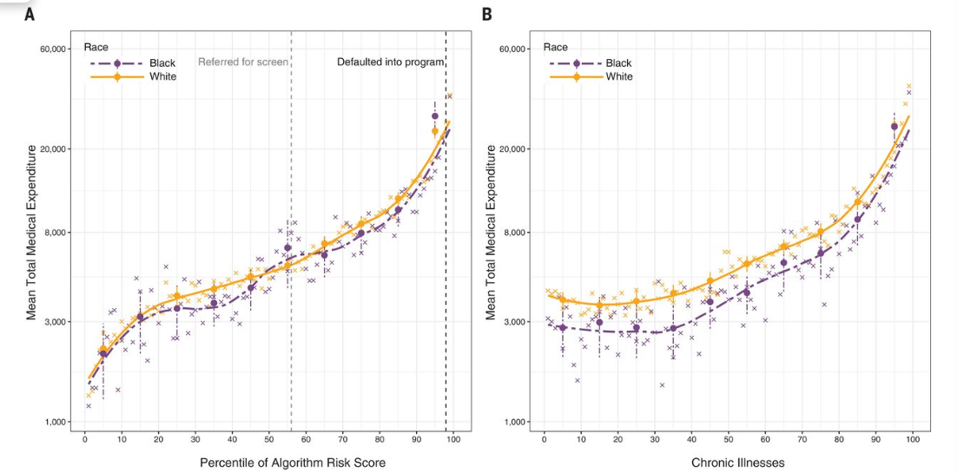
Case Study
Notes:
Cost vs predicted risk. Equal between races. Is our algorithm biased?

Slide 20
Results
Did we choose a good result measure?
Did this algorithm achieve its goal? Was it fair?
Should the algorithm be blinded?
Should we preprocess the data in any way?
Notes:
programs primarily work to prevent acute health decompensations – leading to catastrophic expenditures
could simply predict a measure of health

Slide 21
Pathways for Medical Device Approval
510k
De Novo Approval
Premarket Approval
Exemptions (rare disease, breakthrough)
For the purposes of the FDA, software (including AI) is considered a medical device

Slide 22
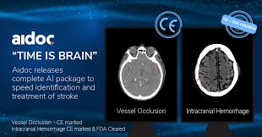
510(k) Pathway for Medical Devices
FDA approval process for medical devices
Must find a “predicate” device with same use
Notes:
If we made a new intracranial hemorrhage detection algorithm, we could cite Aidoc as a

Slide 23
Addressing Data Drift
Predetermined Change Control Plans (PCCPs)
Plan outlining what changes and surveillance will occur ahead of time
Not required for FDA approval

Slide 24
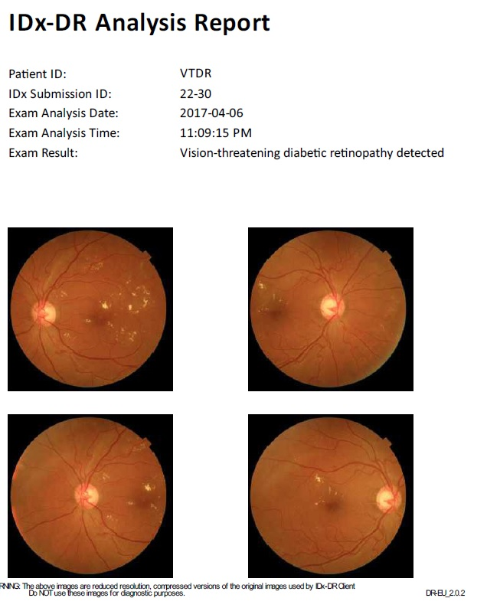
De Novo Device Approval
For devices that have no precedent
Ex. IDX: Diabetic retinopathy
Once approved, can serve as precedent in future 510k

Slide 25
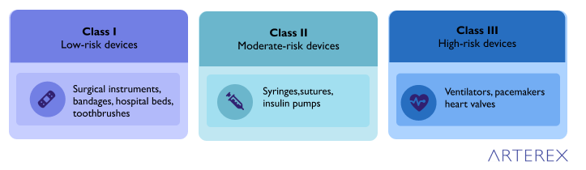
FDA Device Classification
Class I: Low risk (e.g., stethoscope) – usually exempt.
Class II: Moderate risk – majority of AI devices fall here.
Class III: High risk – life-supporting or life-sustaining, needs PMA.

Slide 26
FDA Device Classification
Class I: 510k eligible
Class II: 510k eligible
Class III: Needs pre-market approval

Slide 27
Pre Market Authorization
Needed for high risk medical devices
Design a study for use
During the study, obtain an investigational device exemption for the experimental device
Then, FDA reviews data for clinical approval

Slide 28
Next time:
Project Intro
Practice by coming up with a clinical question of your own

Slide 29
Thanks!

